Slide 1

“ Portfolio Website ”
Task - 1

Slide 2

YourꢀProjectꢀName
▪
YourꢀProjectꢀIntroduction
LMS Username | Name | Batch
au310520104036 | B.Gokul krishnan | 07
au310520104042 | S.Jayaprakash | 07
au310520104039 | G.Hariharan | 07
au310520104130 | K.S.surya | 07
LMS Username
Name
Batch

Slide 3
INTRODUCTION
This work aims to report the process of designing and developing a web portfolio for a graduating bachelor design student specializing in web design and development. It will define what a portfolio website is, it will also explain the basic theory and elements of an online portfolio design process. Further this work presents different ways and channels through which a design student can create and develop a personal online portfolio. By covering aspects such as: how to integrate personal visual identity and what is required to build an effective portfolio. In order to carry out this process, it is essential to understand various strategies and techniques that are used to today, while acquiring skill full understanding of modern tools and trends.

Slide 4
Document Conventions
Entire document should be justified.
➢ Convention for Main title
○ Font face:Times New Roman
○ Font style:Bold
○ Font Size: 14
➢ Convention for Sub title
○ Font face:Times New Roman
○ Font style:Bold
○ Font Size: 12
➢ Convention for body
○ Font face:Times New Roman
○ Font Size: 12

Slide 5
Scope of Development Project
The portfolio website should consists of our main parts such as
personal information, including short cv and professional skills,
portfolio showcase, and contact information including feedback
Form . The Parallax effect possible can be implemented in order to
bring the visual depth and dynamics to graphical objects.
Parallax is a web design technique that allows components of a
web page to move at varying speeds when a user scrolls. In
particular, the effect is created when the background of a web
page moves at a different speed from the rest of the elements
when you scroll.

Slide 6
Definitions, Acronyms and Abbreviations
JAVA -> platform independence
SQL-> Structured query Language
IDE-> Integrated Development Environment
SRS-> Software Requirement Specification

Slide 7
References
Books
○ Airey, D., 2010. Logo Design Love: A Guide to Creating Iconic Brand Identities
○ Berkeley, CA: New Riders
Websites
○ http://www.smashingmagazine.com/2013/06/workflow-design-develop-modern-portfolio-website/
○ http://business.tutsplus.com/articles/the-secret-to-getting-a-lot-of-web-design-work--fsw-390

Slide 8
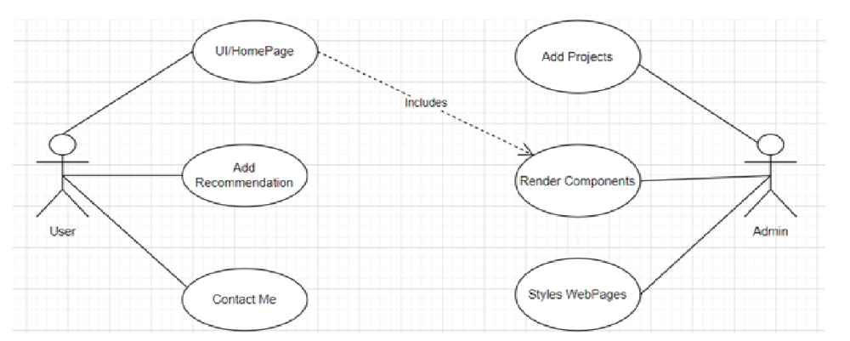
Overall description
Product perspective
Usecase diagram of portfolio website

Slide 9
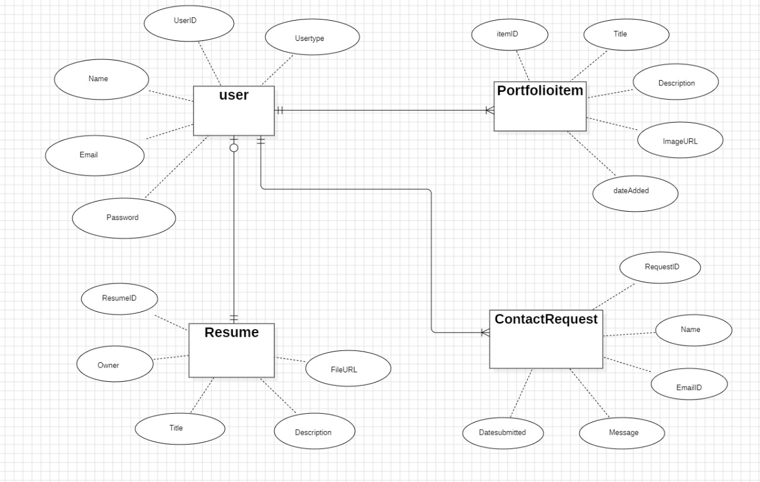
Product function
Entity Relationship Diagram of portfolio website

Slide 10
Class diagram
A class is an abstract, user-defined description of a type of data. It identifies the attributes of the
data and the operations that can be performed on instances (i.e. objects) of the data. A class of
data has a name, a set of attributes that describes its characteristics, and a set of operations that
can be performed on the objects of that class. The classes’ structure and their relationships to
each other frozen in time represent the static model. In this project there are certain main classes which are related to other classes required for their working. There are different kinds of
relationships between the classes as shown in the diagram like normal association, aggregation,
and generalization. The relationships are depicted using a role name and multiplicities. Here
‘user’, ‘project’ , ‘Contact form’ and ‘about me’ are the most important classes which are related to other classes.

Slide 11
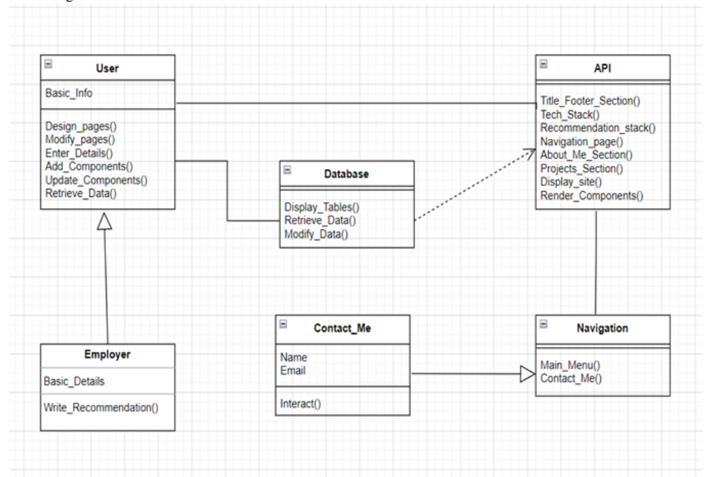

Slide 12

Submission Github
. https://github.com/jayaprakesh2002/NM-DSCET-7

Slide 13


